Slide 1

ONLINE CLASS
GRAPH THEORY
BICTE $6^{TH}$ SEMESTER
2078/02/12
PRESENTED BY KALYAN DAHAL

Slide 2
Welch-Powell Algorithm for colouring
To colour the vertices of a given graph G, we need to follow the following algorithm given by Welch-Powell.
1. List down the vertices of G in decreasing order of degrees in a row and then write the degree of the corresponding vertex in the next row.
2. Select a colour to paint the first vertex on the list of step 1. Then, paint each of the orther vertices on the list (not adjacent to the vertex previously painted) by the same colour and write down on the third row.

Slide 3
Continued……
3. Deal the above list of remaining vertices with highest degree to colour the unpainted vertices using a second colour.
4. Keep continue the process of colouring the unpainted vertices with additional colours until all the vertices get painted.
Note: these steps are very simple which may not work for the complicated graph.

Slide 4

In the given figure, find the chromatic number of the graph.
$v_{1}$ $v_{4}$ $v_{5}$ $v_{6}$ $v_{2}$ $v_{7}$ $v_{3}$

Slide 5
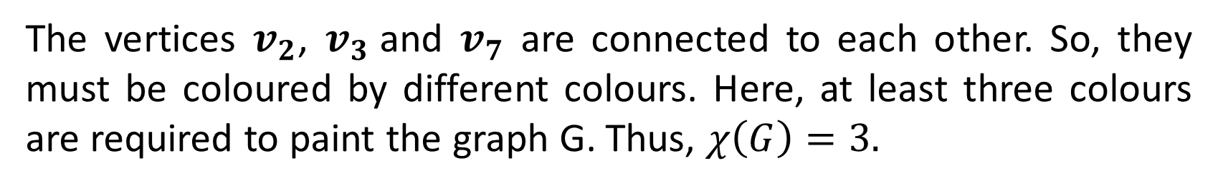
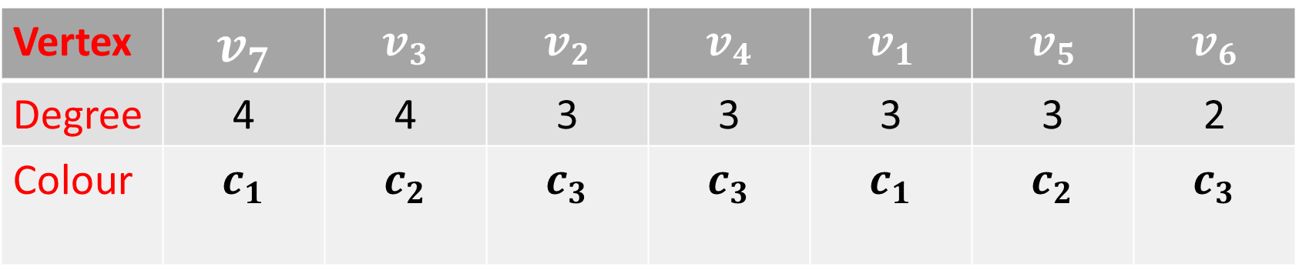
Solution: From the figure we have,
Vertex | $$v_{7}$$ | $$v_{3}$$ | $$v_{2}$$ | $$v_{4}$$ | $$v_{1}$$ | $$v_{5}$$ | $$v_{6}$$
Degree | 4 | 4 | 3 | 3 | 3 | 3 | 2
Colour | $$c_{1}$$ | $$c_{2}$$ | $$c_{3}$$ | $$c_{3}$$ | $$c_{1}$$ | $$c_{2}$$ | $$c_{3}$$
The vertices $v_{2}$, $v_{3}$and $v_{7}$ are connected to each other. So, they must be coloured by different colours. Here, at least three colours are required to paint the graph G. Thus, $χ\left(G\right)=3.$

Slide 6

In the given figure 0f tree, find the chromatic number of the graph.
$v_{4}$ $v_{2}$ $v_{3}$ $v_{8}$ $v_{5}$ $v_{1}$ $v_{7}$ $v_{6}$ $v_{9}$ $v_{10}$

Slide 7
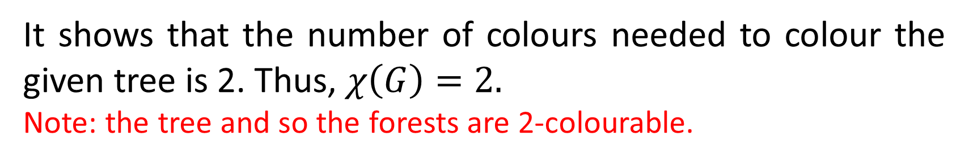
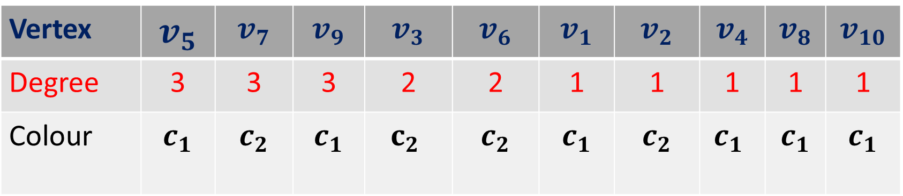
Solution: From the figure we have,
Vertex | $$v_{5}$$ | $$v_{7}$$ | $$v_{9}$$ | $$v_{3}$$ | $$v_{6}$$ | $$v_{1}$$ | $$v_{2}$$ | $$v_{4}$$ | $$v_{8}$$ | $$v_{10}$$
Degree | 3 | 3 | 3 | 2 | 2 | 1 | 1 | 1 | 1 | 1
Colour | $$c_{1}$$ | $$c_{2}$$ | $$c_{1}$$ | $$c_{2}$$ | $$c_{2}$$ | $$c_{1}$$ | $$c_{2}$$ | $$c_{1}$$ | $$c_{1}$$ | $$c_{1}$$
It shows that the number of colours needed to colour the given tree is 2. Thus, $χ\left(G\right)=2.$
Note: the tree and so the forests are 2-colourable.

Slide 8
Theorem: Every tree with two or more vertices is 2 chromatic.
Proof: let T be a rooted tree. Then, it has a fixed root say v. colour it with colour 1. Colour all the vertices adjacent to v with colour 2 as shown in the figure.
1 2 2 2 1 1 1 1 2 2 2 2 2 2 2 2

Slide 9
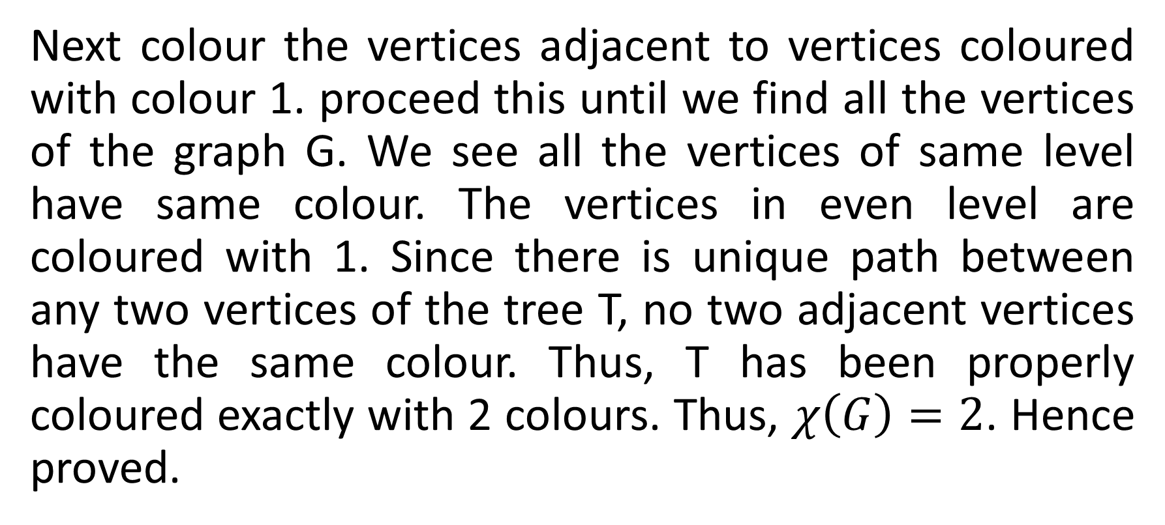
Continued…..
Next colour the vertices adjacent to vertices coloured with colour 1. proceed this until we find all the vertices of the graph G. We see all the vertices of same level have same colour. The vertices in even level are coloured with 1. Since there is unique path between any two vertices of the tree T, no two adjacent vertices have the same colour. Thus, T has been properly coloured exactly with 2 colours. Thus, $χ\left(G\right)=2$. Hence proved.

Slide 10
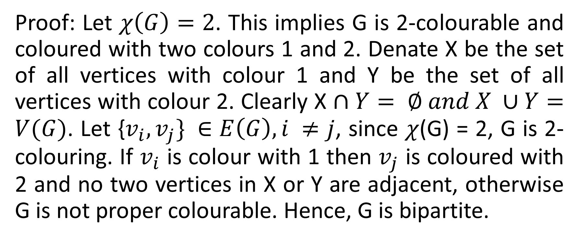
Theorem: A graph is 2-chromatic iff G is bipartite.
Proof: Let $χ\left(G\right)=2$. This implies G is 2-colourable and coloured with two colours 1 and 2. Denate X be the set of all vertices with colour 1 and Y be the set of all vertices with colour 2. Clearly X $∩Y= ∅ and X ∪Y=V(G)$. Let {$v_{i}, v_{j}\} ∈E\left(G\right), i ≠j$, since $χ$(G) = 2, G is 2-colouring. If $v_{i}$ is colour with 1 then $v_{j}$ is coloured with 2 and no two vertices in X or Y are adjacent, otherwise G is not proper colourable. Hence, G is bipartite.

Slide 11
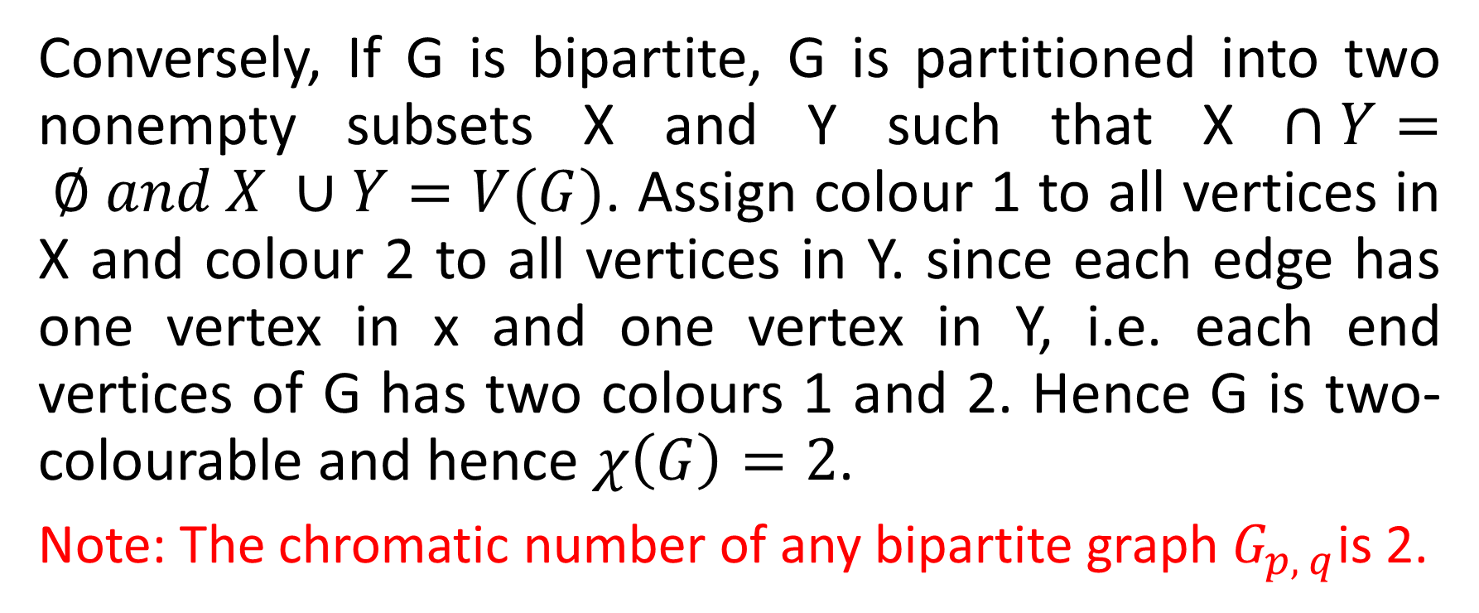
Continued….
Conversely, If G is bipartite, G is partitioned into two nonempty subsets X and Y such that X $∩Y= ∅ and X ∪Y=V(G)$. Assign colour 1 to all vertices in X and colour 2 to all vertices in Y. since each edge has one vertex in x and one vertex in Y, i.e. each end vertices of G has two colours 1 and 2. Hence G is two-colourable and hence $χ\left(G\right)=2$.
Note: The chromatic number of any bipartite graph $G_{p, q}$is 2.

Slide 12
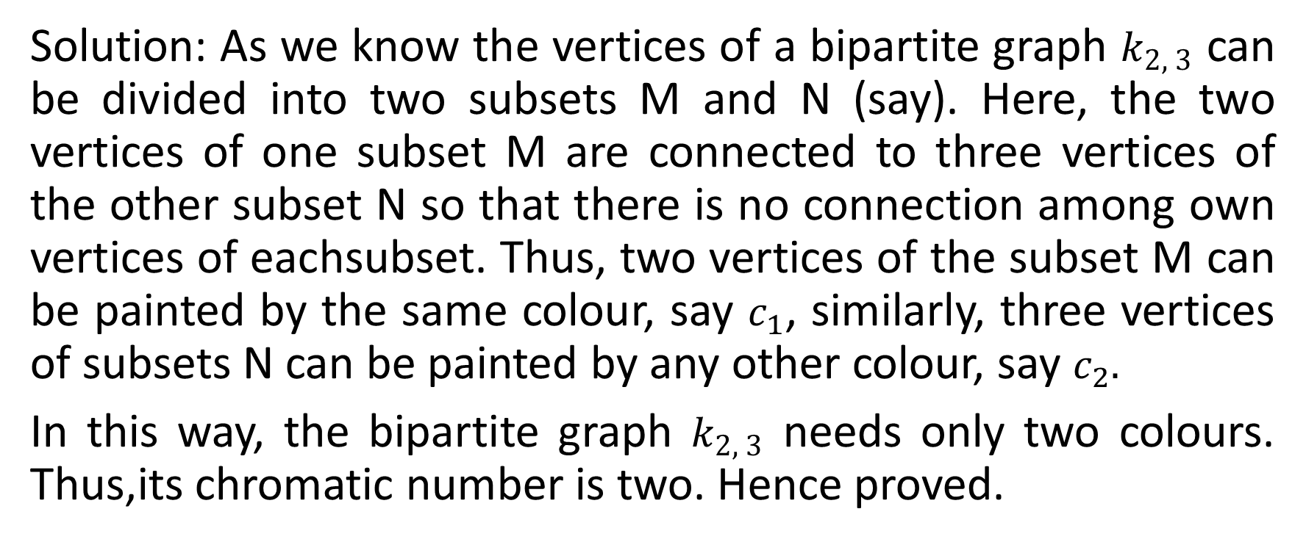

Show that the chromatic numbers of the bipartite graphs $k_{2, 3}$ is two.
Solution: As we know the vertices of a bipartite graph $k_{2, 3}$ can be divided into two subsets M and N (say). Here, the two vertices of one subset M are connected to three vertices of the other subset N so that there is no connection among own vertices of eachsubset. Thus, two vertices of the subset M can be painted by the same colour, say $c_{1}$, similarly, three vertices of subsets N can be painted by any other colour, say $c_{2}.$
In this way, the bipartite graph $k_{2, 3}$ needs only two colours. Thus,its chromatic number is two. Hence proved.

Slide 13


